Slide 1
Form in HTML
Unit 5

Slide 2
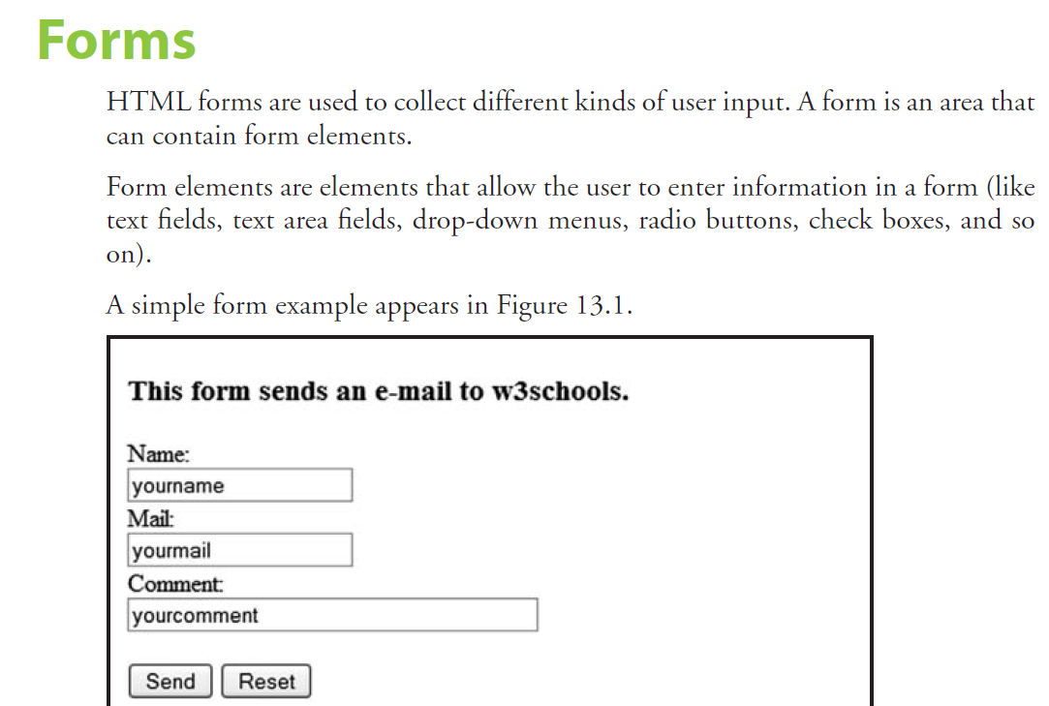

Slide 3
A form is defined with the <form> tag:
<form>
input elements
</form>

Slide 4
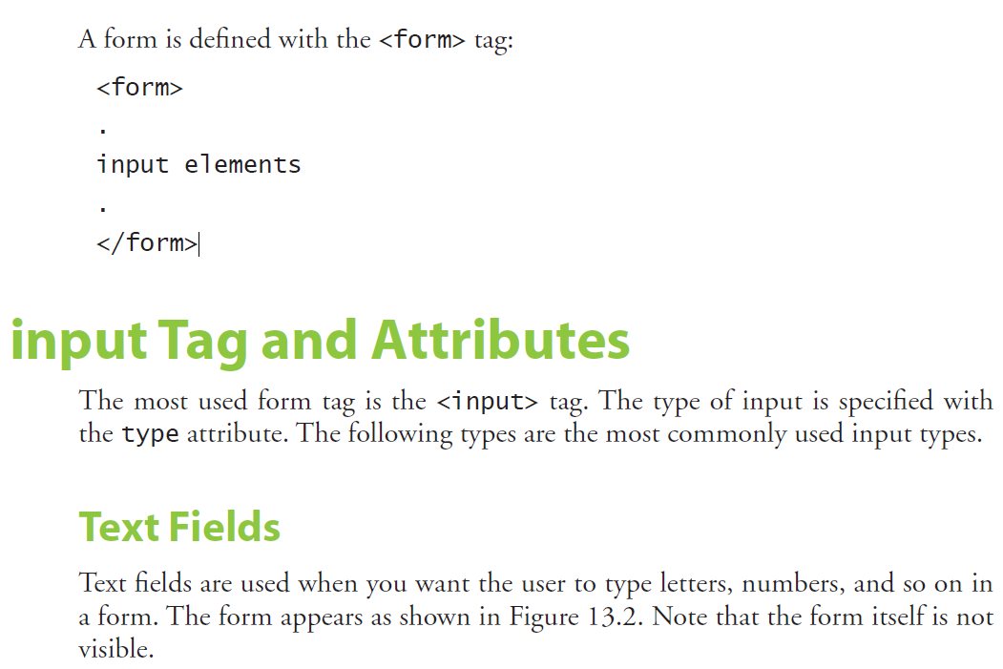

Slide 5
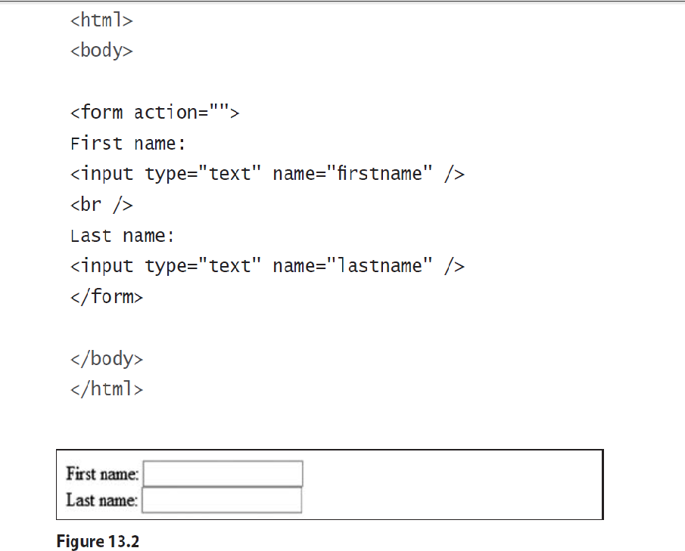

Slide 6
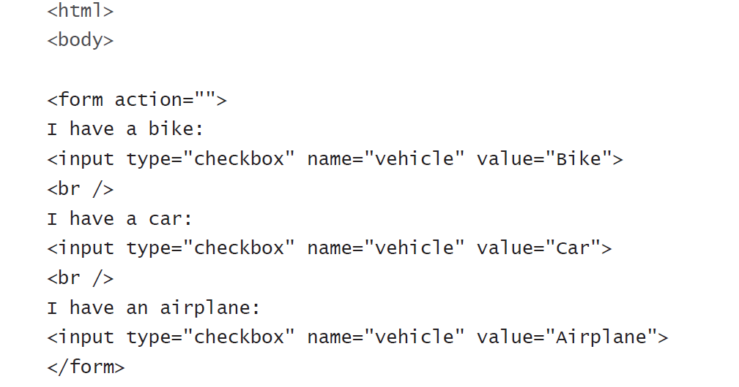
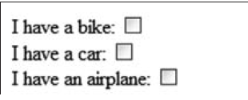
Check Boxes
A user can select or deselect a check box.

Slide 7
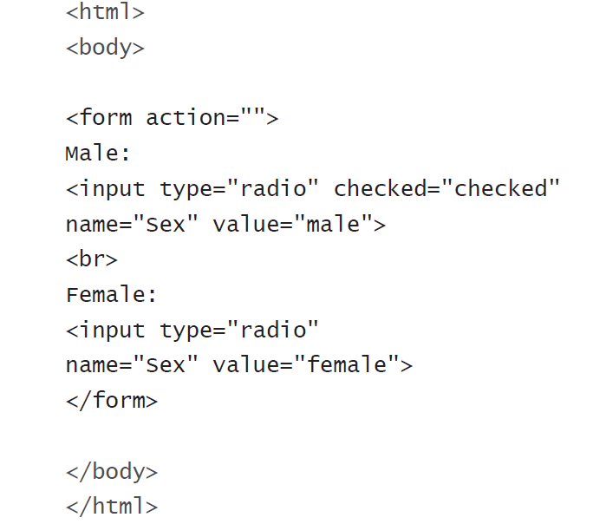
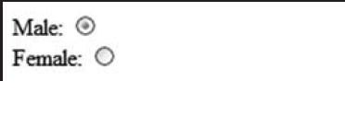
Radio Buttons
When a user clicks a radio button, that button becomes selected, and
all other buttons in the same group become deselected.

Slide 8
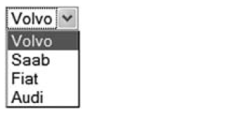
Drop-Down List
A drop-down list is a selectable list.
<html><body>
<form action="">
<select name="cars">
<option value="volvo">Volvo</option>
<option value="saab">Saab</option>
<option value="fiat">Fiat</option>
<option value="audi">Audi</option>
</select>
</form>
</body>
</html>

Slide 9
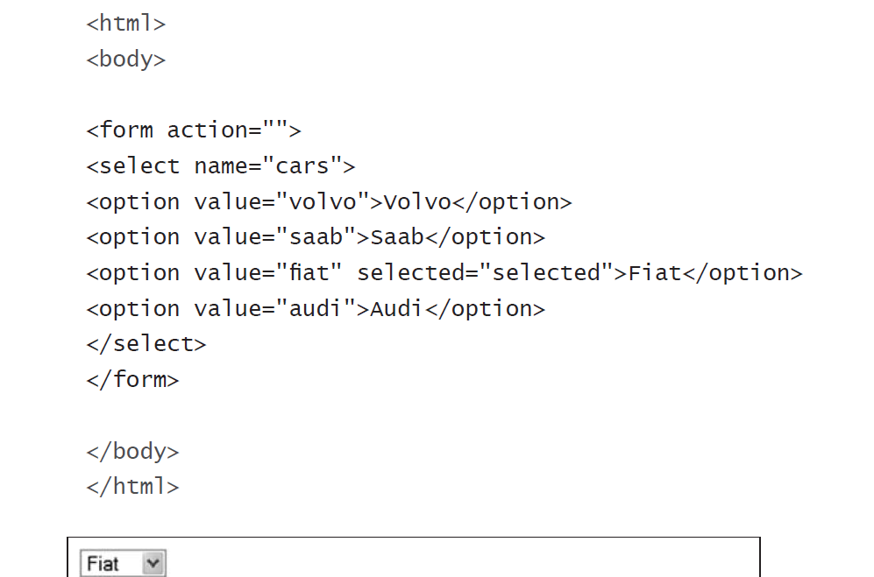

Slide 10
Text Area
Using a textarea (a multiline text input control) we can write an unlimited number of characters.
A textarea can be in a form or elsewhere on a page.

Slide 11
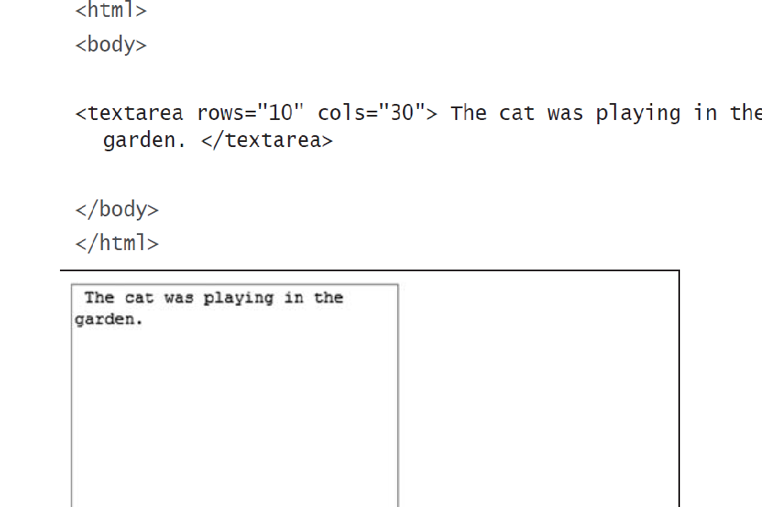

Slide 12

Buttons
Buttons are common items on a form.
This example demonstrates how to create a button.
we can define your own text on the face of the button.
<html>
<body>
<form action="">
<input type="button" value="Hello world!">
</form>
</body>
</html>

Slide 13
Fieldset
A fieldset is a grouping of data fields.
Following example demonstrates how to draw a border with a caption around our data,

Slide 14
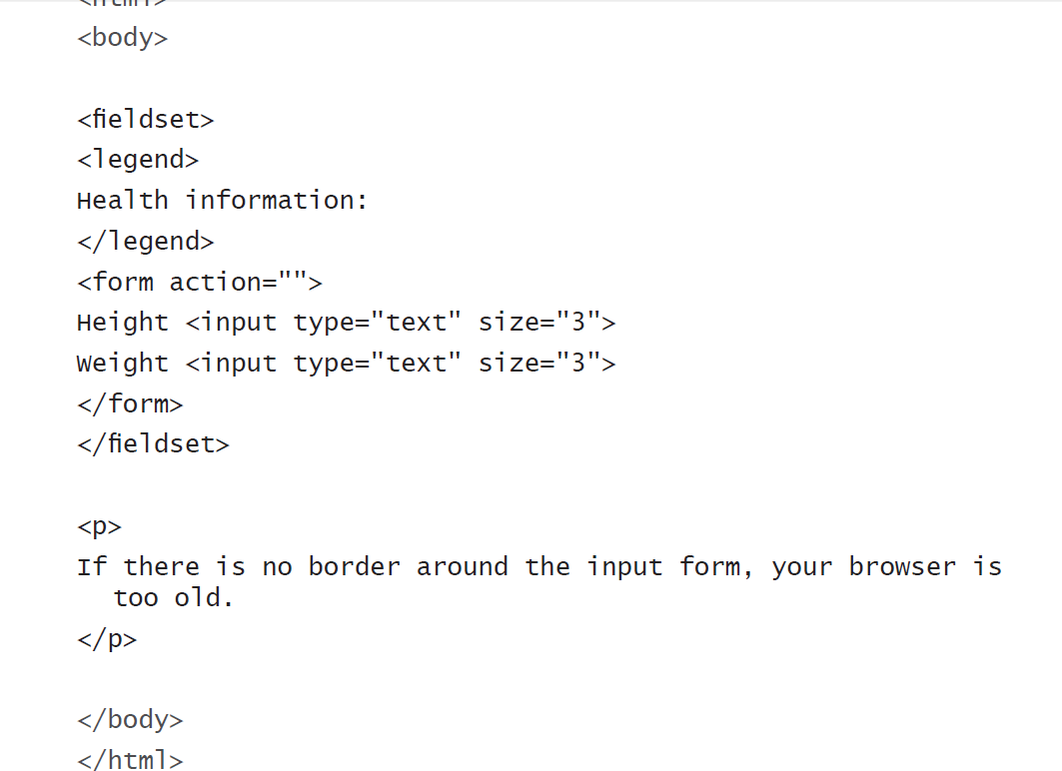
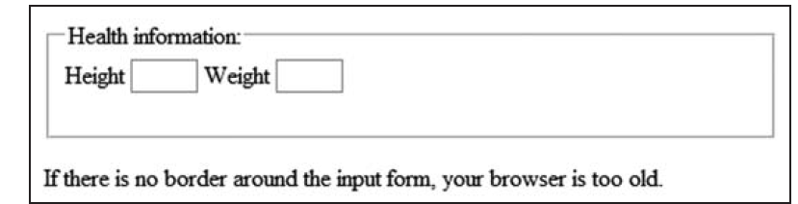

Slide 15
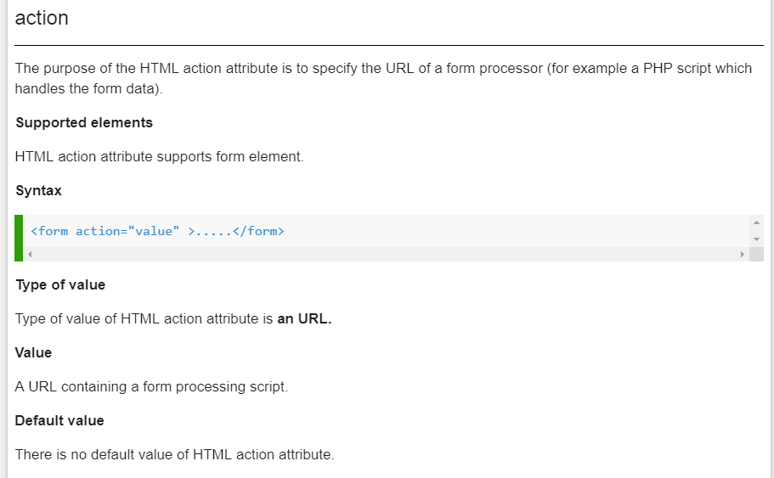
Action attribute in form

Slide 16

Demo of action attribute
<html>
<body>
<form action="https://www.w3schools.com">
Email id : <input type="text" name="email"/><br />
Password : <input type="text" name="passw"/><br />
<input type="submit" value="Submit" />
</form>
</body>
</html>

Slide 17
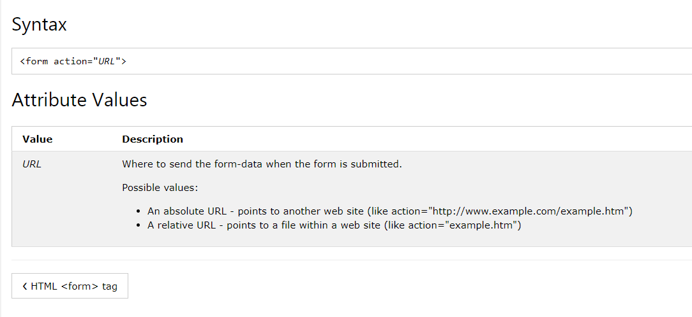

Slide 18
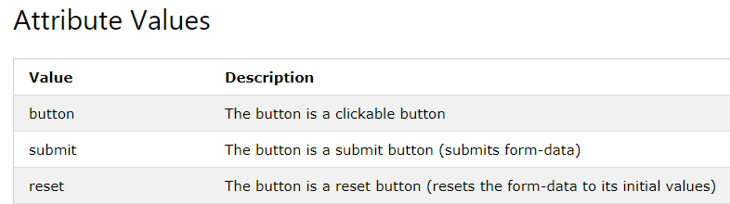
Submit and reset button in Html
HTML <button> type Attribute
Syntax
<button type="button|submit|reset">

Slide 19
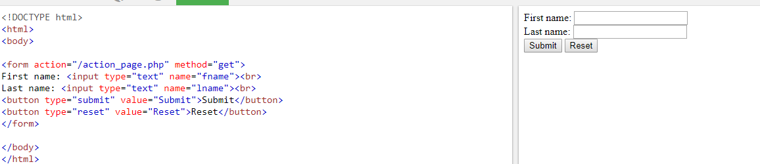

Slide 20
The Target Attribute
The target attribute specifies if the submitted result will open in a new browser tab, a frame, or in the current window.
The default value is "_self" which means the form will be submitted in the current window.
To make the form result open in a new browser tab, use the value "_blank":

Slide 21
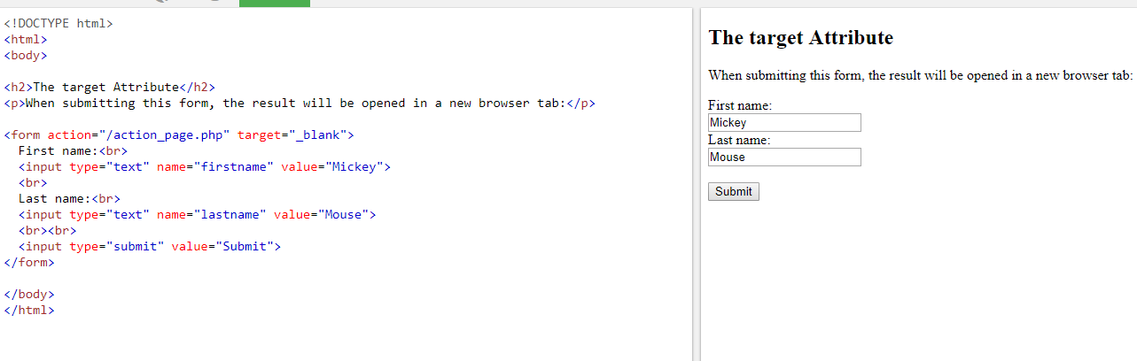

Slide 22
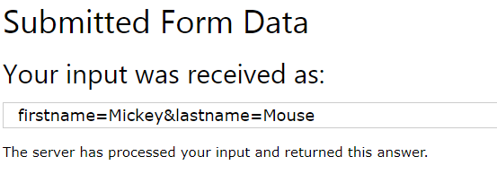

Slide 23
Demo of The Method Attribute
The method attribute specifies the HTTP method (GET or POST) to be used when submitting the form data:

Slide 24
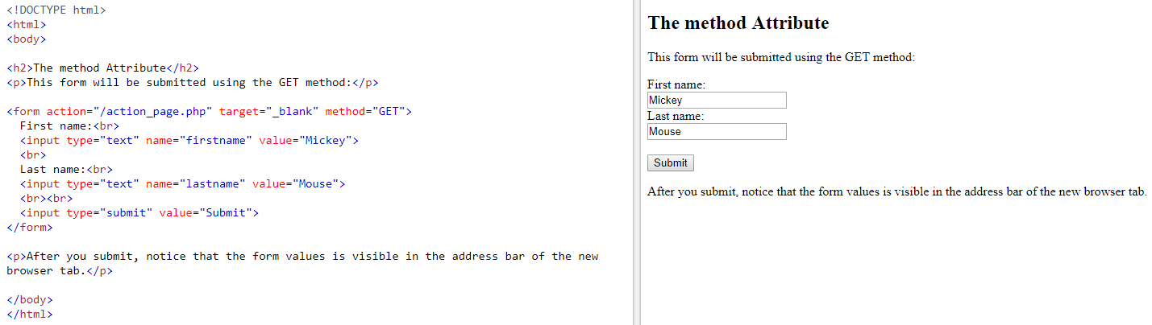

Slide 25
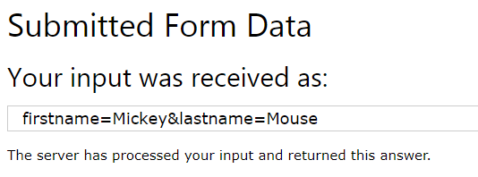

Slide 26
When to Use GET?
The default method when submitting form data is GET.
However, when GET is used, the submitted form data will be visible in the page address
field:/action_page.php?firstname=Mickey&lastname=Mouse

Slide 27
Get Method
Appends form-data into the URL in name/value pairs
The length of a URL is limited (about 3000 characters)
Never use GET to send sensitive data! (will be visible in the URL)
Useful for form submissions where a user wants to bookmark the result
GET is better for non-secure data, like query strings in Google

Slide 29
When to Use POST?
Always use POST if the form data contains sensitive or personal information. The POST method does not display the submitted form data in the page address field.
Notes on POST:
POST has no size limitations, and can be used to send large amounts of data.

Slide 30
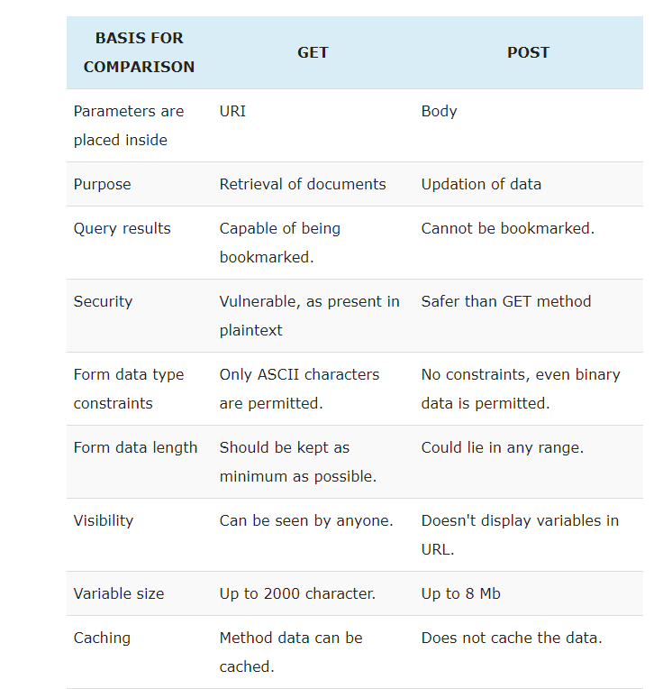

Slide 31
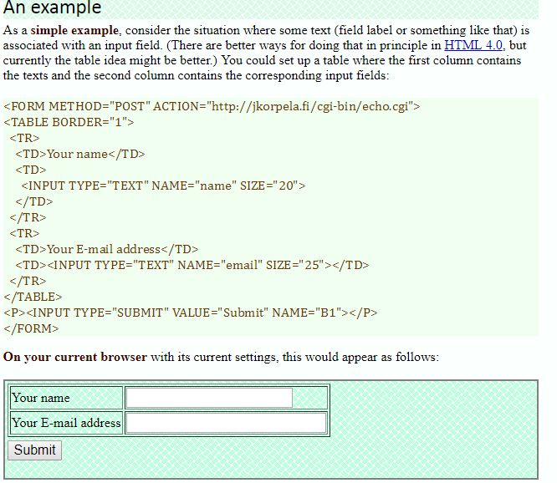
Using table to layout form

Slide 32
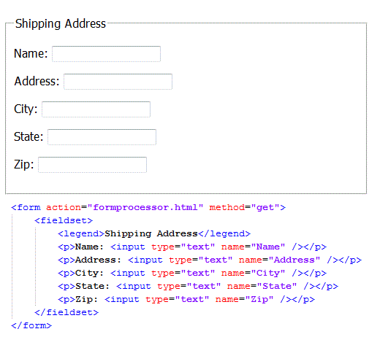

Slide 33
<label for="email">Enter your email:</label>
<input type="email" id="email" name="email">

Slide 34
Definition and Usage
The <input type="email"> defines a field for an e-mail address.
The input value is automatically validated to ensure it is a properly formatted e-mail address.

